Slide 1
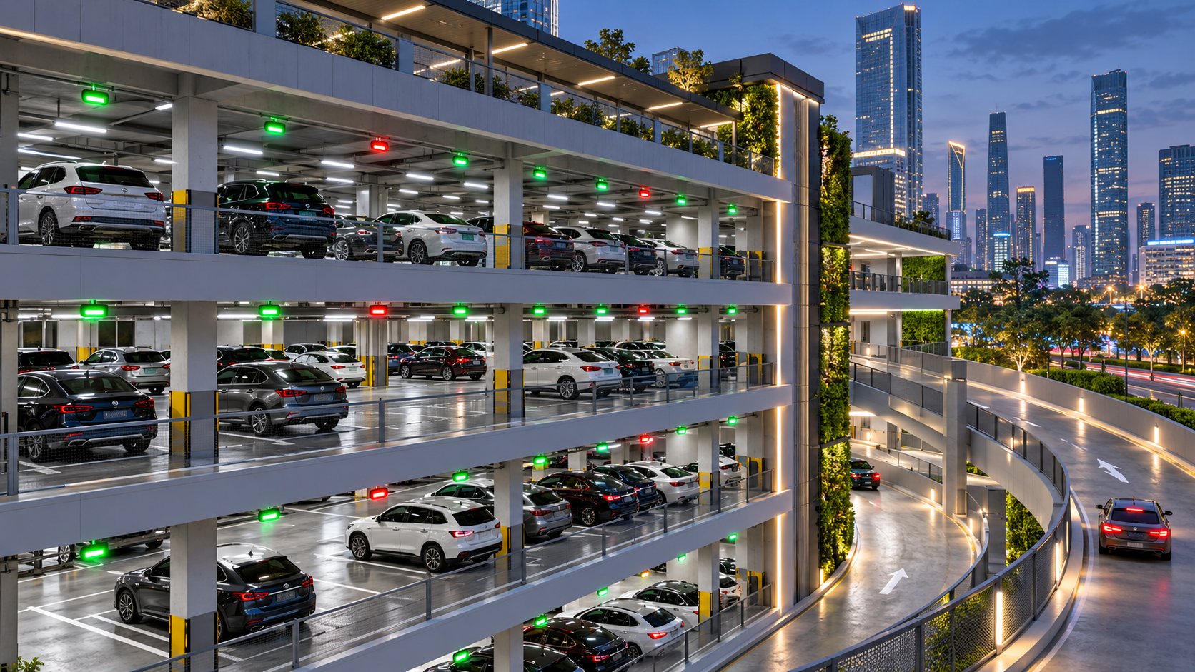
CAMPUS / URBAN INFRASTRUCTURE
MULTI-LEVEL
PARKING
SYSTEM
A smarter way to organize real parking space—across floors, gates and every available slot.
SPACE • MOVEMENT • MANAGEMENT
ML PARKING / 01

Slide 2
01 / CONTEXT
The parking problem
Adding more floors increases capacity. Without guidance, it can also make finding a space harder.
TODAY’S CHALLENGE
OUR APPROACH
Drivers circle between floors
Give every vehicle a clear route
Limited visibility of vacant slots, crowded ramps and manual entry records create delays.
Show level-wise availability, assign a free slot, track gate movement and maintain a single occupancy record.
WHY THIS PROJECT?
It connects a physical building with a practical digital management system.
ML PARKING / 02

Slide 3
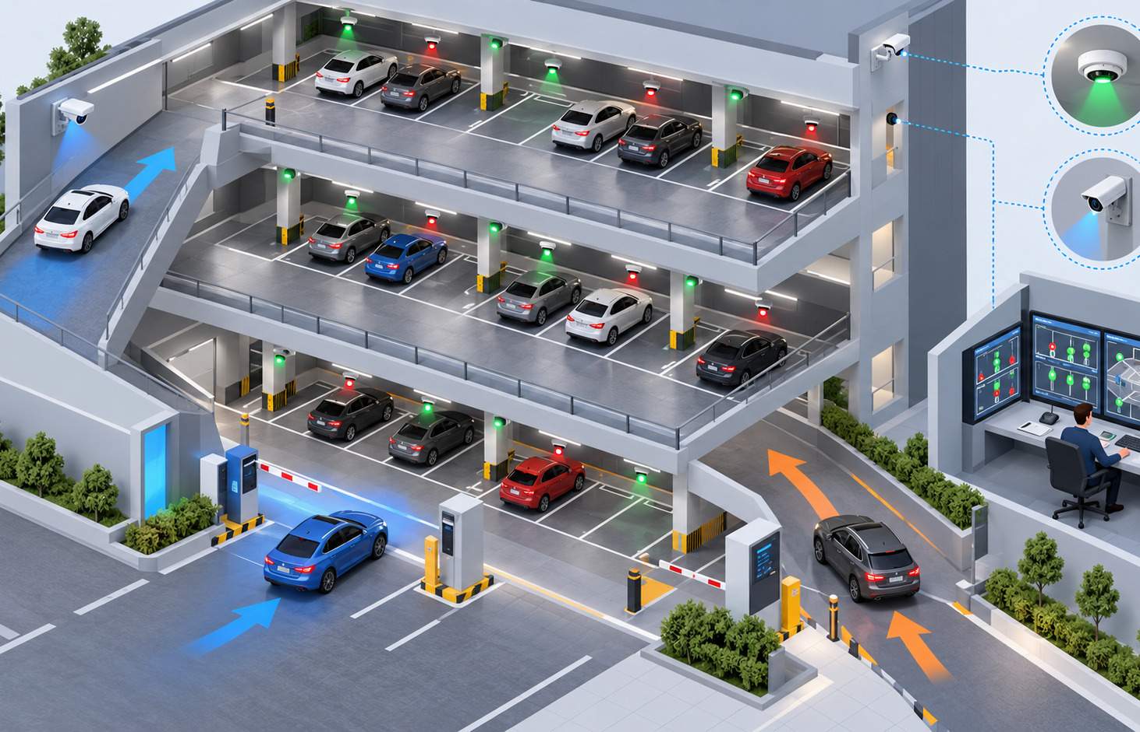
02 / PHYSICAL DESIGN
Inside a real multi-level car park
Each feature in the application corresponds to a physical part of the parking facility.
01
FLOORS & RAMPS
Vehicle movement across multiple decks.
02
ENTRY / EXIT
Controlled gates register each visit.
03
SLOT INDICATORS
Free and occupied spaces are easy to locate.
04
CONTROL ROOM
Staff monitor the building and its occupancy.
ML PARKING / 03

Slide 4
03 / OPERATION
One vehicle. Five coordinated steps.
Follow how a driver interacts with both the parking structure and the software.
01
02
03
04
05
ARRIVAL
AVAILABILITY
ALLOCATION
OCCUPANCY
EXIT
→
→
→
→
Vehicle details are recorded at the entry gate.
The system checks vacant slots on every floor.
An appropriate floor and slot are assigned.
The parking status changes when the car parks.
Exit is recorded; the slot is released again.
PHYSICAL + DIGITAL
Gates, floor layouts and slot occupancy all feed into the same system.
ML PARKING / 04

Slide 5
04 / SOFTWARE MODEL
The five project modules
A clear software structure that mirrors what happens in the actual parking building.
01
02
03
04
05
Vehicle entry
Slot allocation
Availability view
Exit & billing
Admin dashboard
Register the car, driver details and arrival time.
Find a suitable free slot on the selected floor.
Display live free / occupied spaces by level.
Record departure, duration and vacancy.
Monitor capacity, vehicle logs and reports.
SHARED PARKING DATABASE
DB
Vehicle details • Floor & slot status • Entry and exit logs
Every module reads or updates the same set of parking records.
ML PARKING / 05

Slide 6
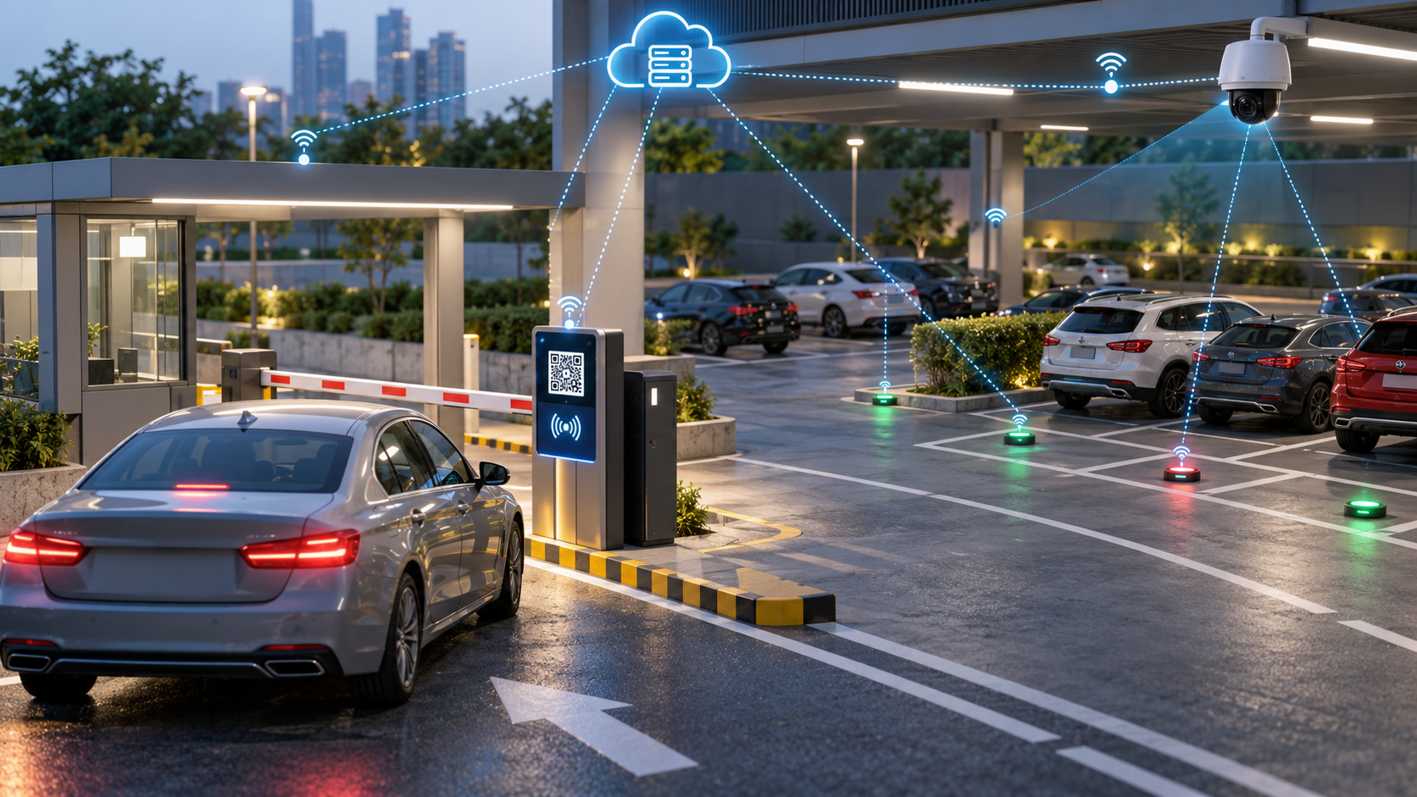
05 / IMPACT & FUTURE SCOPE
A better
parking
experience
LESS SEARCH TIME
Direct drivers to known vacant spaces.
BETTER SPACE USE
Distribute demand across all floors.
CLEARER RECORDS
Keep arrivals, departures and occupancy organized.
NEXT: SMARTER AUTOMATION
Sensors, QR/RFID entry, mobile guidance and digital payments.
ML PARKING / 06

